Slide 1
THE METRIC SYSTEM
With Dimensional Analysis

Slide 2
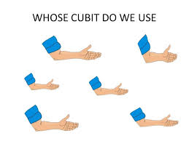
A BRIEF HISTORY…
Measurements were first based on the dimensions of the human body.
A cubit (Ancient Egypt) = distance from elbow to end of middle finger.
An inch (unknown origin) = width of thumb.
A foot (unknown origin) = distance from heel to the tip of big toe.
Consider the wide variety of measurements!

Slide 3
A BRIEF HISTORY (cont.)…
Obviously, body parts do not allow for consistent and accurate measurements
17th century – British Empire introduced “Imperial System”
British units had been in place for centuries, so units tended to be quirky and difficult
1795 – France developed International System of Units (SI), AKA the metric system
Metric measurements were designed to connect and be easier to use

Slide 4
TWO SYSTEMS OF MEASUREMENT Some Common Units
ENGLISH SYSTEM
Inches
Feet
Pounds
Ounces
Gallons
METRIC (SI) SYSTEM
Centimeters
Meters
Kilograms
Grams
Liters

Slide 5
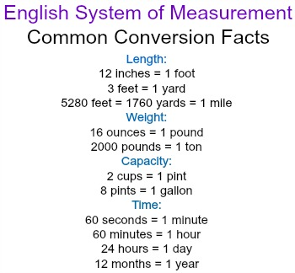
THE ENGLISH SYSTEM
Currently used in only 3 countries worldwide – US, Liberia, Myanmar
Multiple units/names for each physical quantity
No consistent relationship (number) between units
Requires use of fractions and complicated calculations

Slide 6
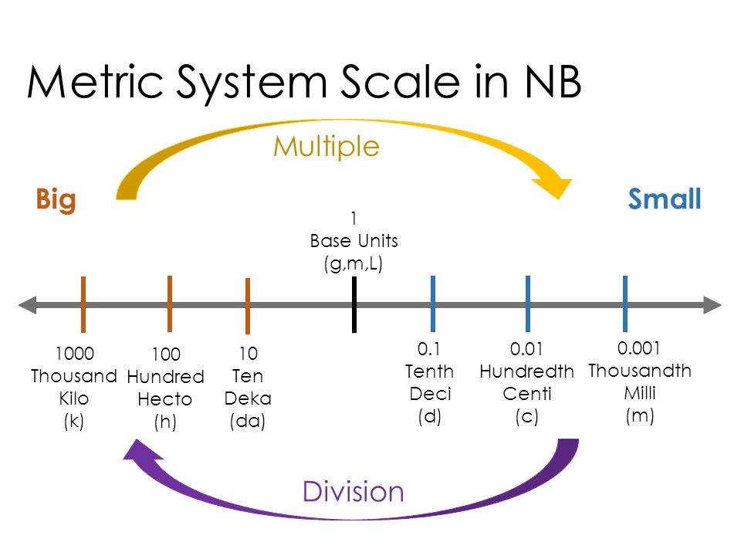
THE METRIC SYSTEM
Worldwide accepted measurement system
Uses only one base unit/name for each physical quantity
For example, length = meter
Based on number ten (10)
No fractions or complicated calculations

Slide 7
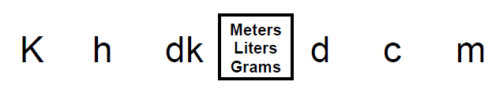
METRIC CONVERSIONS King Henry Method
Move decimal right or Multiply
Move decimal left or Divide
Base Unit

Slide 8
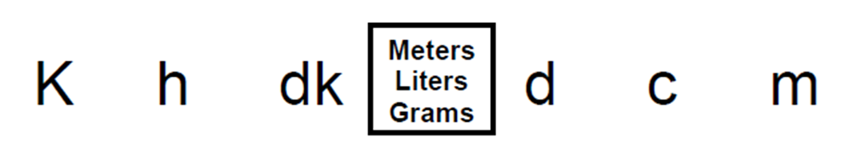
METRIC SYSTEM PRACTICE King Henry Method
37.52 kg = ____ g
214 mL = ____ hL
1.14 dm = ____ dkm
1 cm = ____ mm

Slide 9
METRIC SYSTEM PRACTICE King Henry Method
73.25 mg = ____ dg
534 cL = ____ L
3.83 km = ____ dkm
17 mm = ____ cm

Slide 10
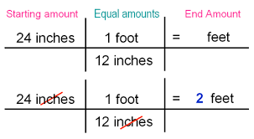
DIMENSIONAL ANALYSIS
Also called “factor-labeling”
Converts from one set of measurements to another set of measurements
Requires use of equivalent factors (equal amounts) given in a conversion table

Slide 11
DIMENSIONAL ANALYSIS PRACTICE Within One System of Measurement
62,956.5 inches = ______ miles
12 ounces into gallons

Slide 12
DIMENSIONAL ANALYSIS PRACTICE Within One System of Measurement
453.8 tons = _____ lbs
100 yards into miles

Slide 13
DIMENSIONAL ANALYSIS PRACTICE Between the Two Systems of Measurement
645 inches = ____ centimeters
15,647 mL into gallons

Slide 14
DIMENSIONAL ANALYSIS PRACTICE Between the Two Systems of Measurement
180 pounds = _____ kg
162 mm into feet

Slide 15
DIMENSIONAL ANALYSIS PRACTICE Word Problems
How many liters is a half gallon of milk equivalent to?
The Boston Marathon is the world’s most prestigious road racing events. The marathon is 42.195 kilometers in length. How many miles is the marathon?

Slide 16
DIMENSIONAL ANALYSIS PRACTICE Word Problems
Your 4 year old pediatric patient weighs 40 pounds. She is febrile. You need to administer acetaminophen (Tylenol)15mg/kg. How many mg will you administer?

Slide 17
TEAS SAMPLE QUESTIONS
Which would be the approximate mass of a car?
1,800 kg
18 kg
180 kg
180,000 kg
Which of the following units would you most likely use to measure the mass of baking soda as part of a lab experiment?
kg
g
cm³
mL

Slide 18
TEAS SAMPLE QUESTIONS
Which would be the approximate mass of a car?
1,800 kg
18 kg
180 kg
180,000 kg
Which of the following units would you most likely use to measure the mass of baking soda as part of a lab experiment?
kg
g
cm³
mL

Slide 19
INDEPENDENT PRACTICE
44 cm = _____ km
65 oz = _____ L
How many minutes are in 19 hours?
A length of glass tubing is 0.535 m. How many inches is the tubing?
The doctor orders 60 mg of Chloramphenicol. The vial is labeled 1 g/10 mL. How many mL would you administer?

Slide 20
INDEPENDENT PRACTICE Answers
44 cm = _0. 00044__ km
65 oz = __1.9___ L
How many minutes are in 19 hours? 1,140 minutes
A length of glass tubing is 0.535 m. How many inches is the tubing? 21.06 in
The doctor orders 60 mg of Chloramphenicol. The vial is labeled 1 g/10 mL. How many mL would you administer? 0.6 mL

